Slide 1
Moga Yoga
Huddle
Group members:
Vincent, DJ,
Kimberly, Munyee

Slide 2
Table of Contents
01
02
03
04
Introduction
EDA
Kimberly
Mun Yee
Modelling Process
Conclusion & Recommendations
DJ
Vincent

Slide 3
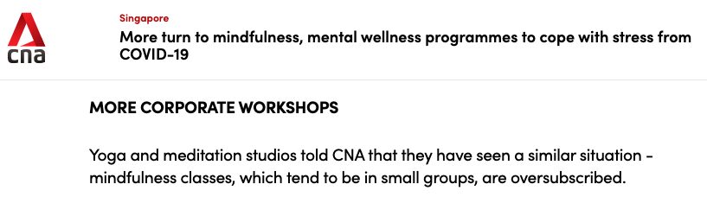
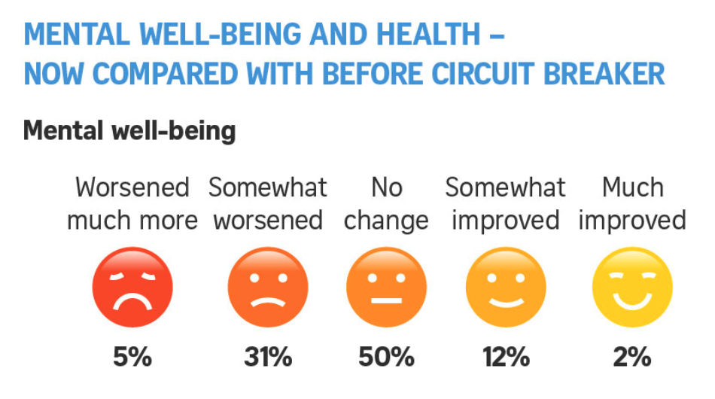
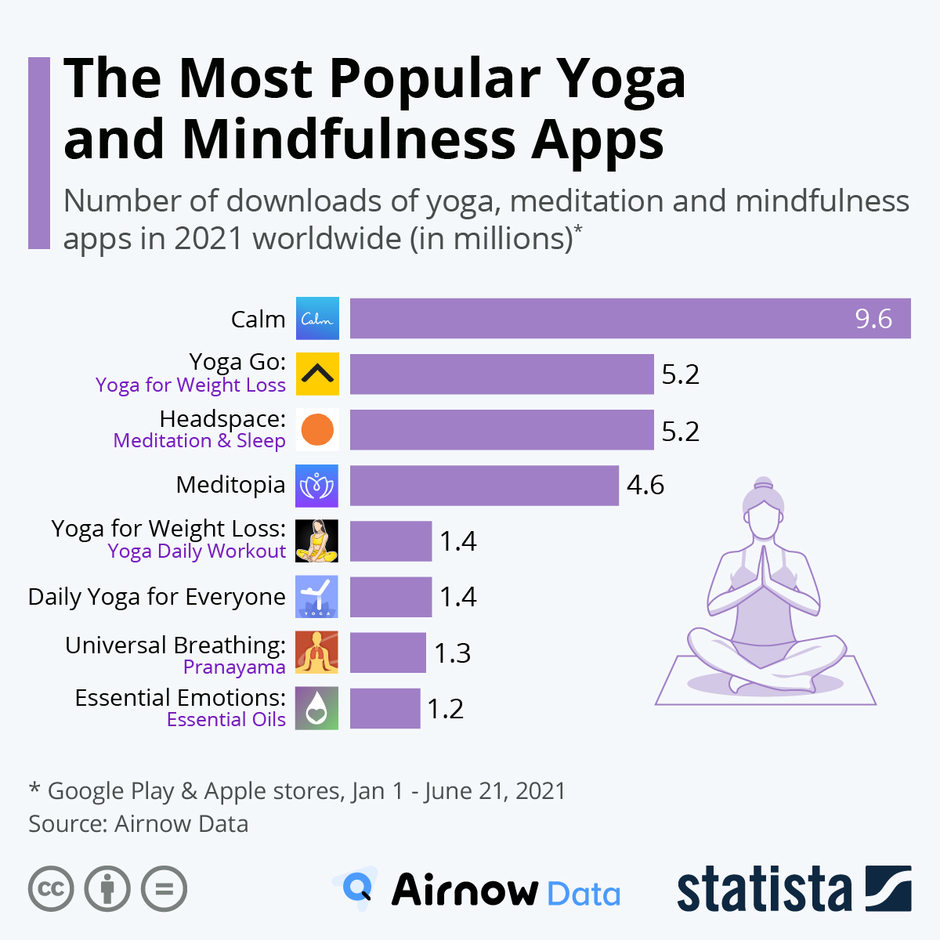

Background
The pandemic has taken a toll on the mental well-being of Singaporeans and has driven a demand for meditation/yoga apps or classes.
Opportunity for customer base expansion
Need to tailor advertisements to promote yoga as a coping strategy / self-care tool

Slide 4
Subreddit Classification- r/yoga vs r/Meditation
NLP Classification

Slide 5
Aims
Identify top predictors for r/yoga
Investigate yoga enthusiasts wants and needs
Identify trending words for yoga or common trending words for both subreddits
To tailor advertisements
Possibly target meditation seekers to consider taking up yoga

Slide 6
Scraping Reddit Data
1500 posts
1500 posts
r/yoga
r/Meditation
Scrapped backwards from
2021-12-31

Slide 7
Data cleaning
01
02
03
04
Null Values
Text/Image/Video selection
Dropped all the rows with null values.
In this analysis, we will focus on text only. Dropped all image and video posts.
Duplicates removal
Removed posts
Some authors reposted updates on the same topic or repetition of posts. These will be removed and only keep the latest post.
Some author deleted their posts. These will be dropped as well.

Slide 8
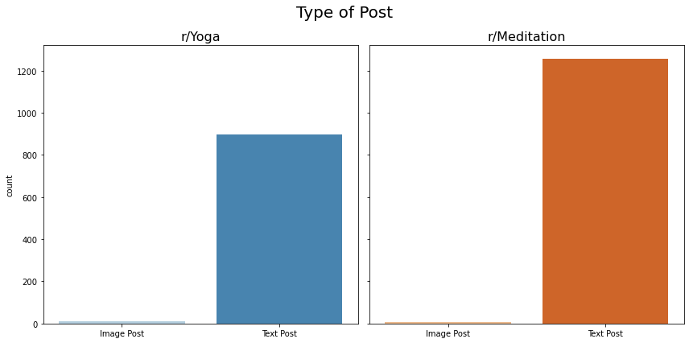
EDA: Type of post
Most posts in both yoga and meditation are text posts. We will remove those that are image posts for this study.

Slide 9
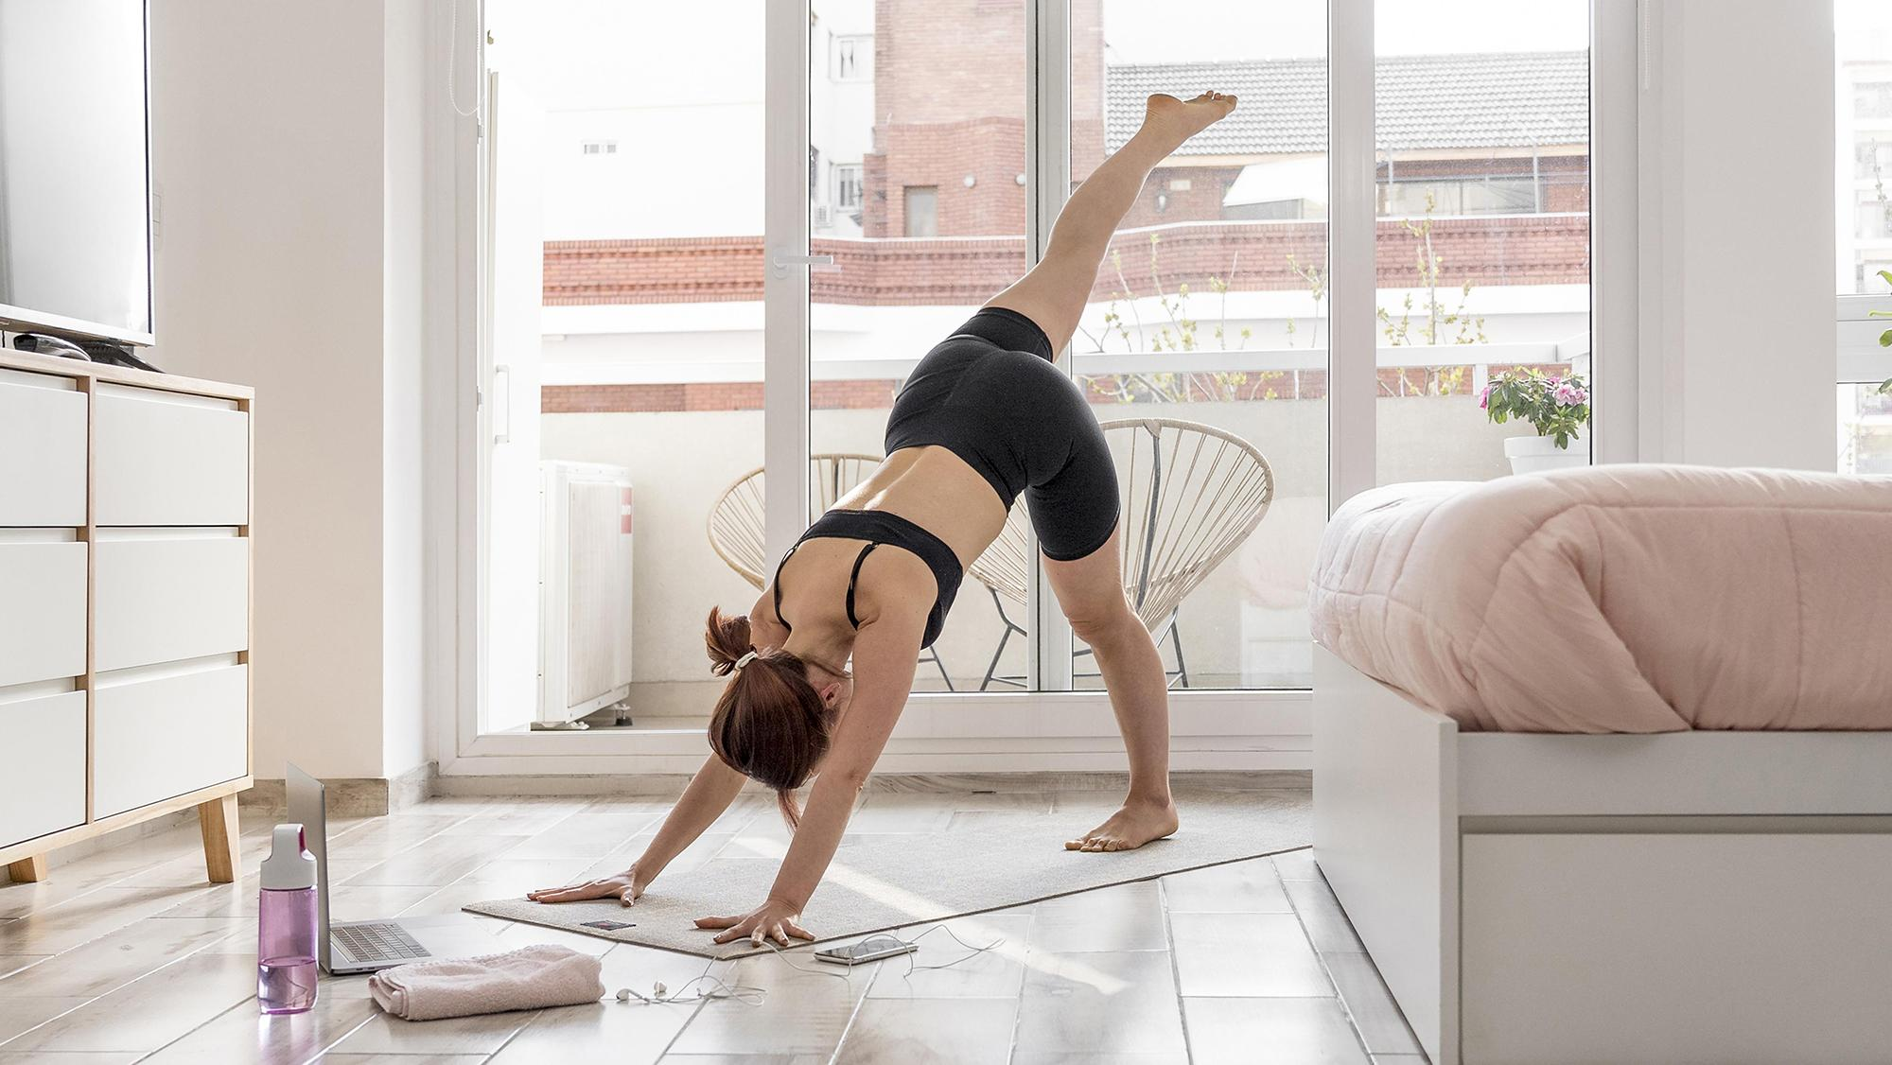
EDA:
Data Exploratory Analysis

Slide 10
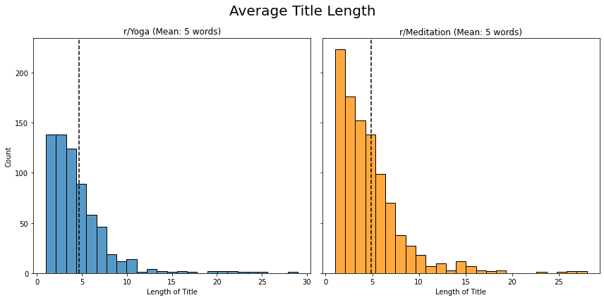
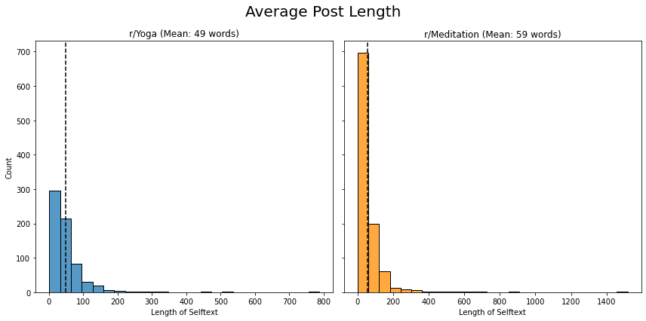
EDA: Word Length
Title length
Meditation has higher number of words in the title compared to yoga.
Post length
Similarly, Meditation posts are longer than yoga posts.
→This makes it easier to predict whether a post comes from meditation in the classifier since there are more features to study.

Slide 11
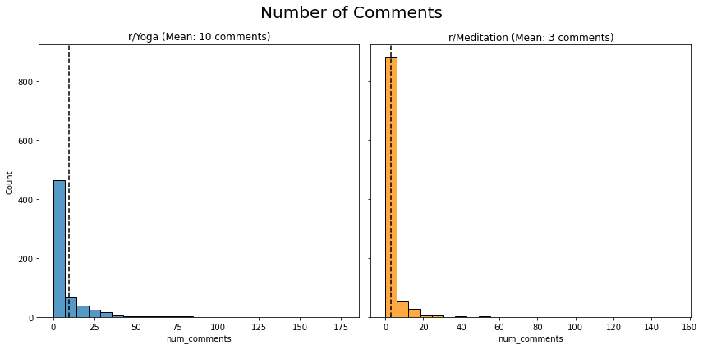
EDA: Number of comments
From the histogram, yoga posts have higher number of comments compared to meditation subreddit, indicating higher participation from yoga users.
Yoga
Meditation

Slide 12
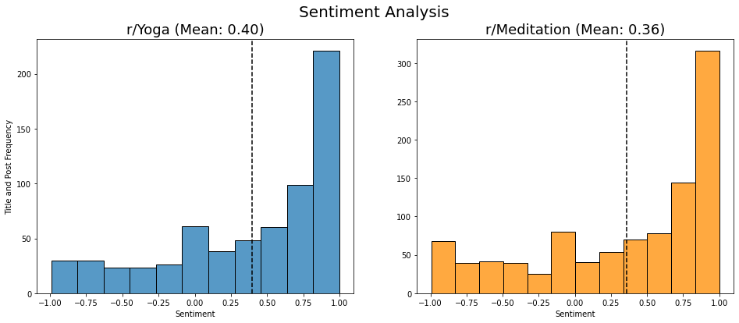
EDA: Sentiment Analysis
The sentiment is mainly positive for both r/yoga and r/meditation with yoga slightly more positive which is a good motivation to promote new users to join. We also see higher number of title and post leaning towards positive sentiment as well which further strengthens the direction.

Slide 13
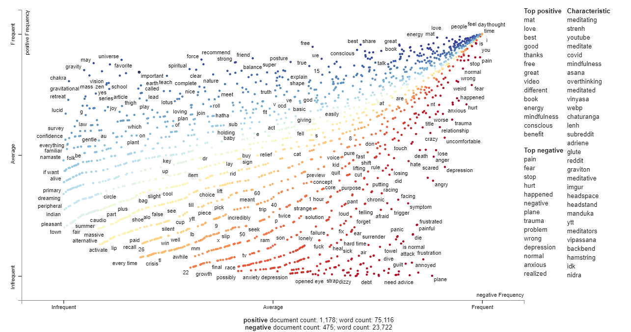
EDA: Sentiment Analysis
The words in blue (+) such as mat, love, best are used in both r/yoga and r/meditation.
Higher frequency in meditation → lengthy posts.
The top words in red(-) such as (pain) come from r/yoga
→ some people struggle to do the poses w/o instructor supervision.
Top negative word (fear) from meditation
→ experience fear when they are meditating and is trying to overcome it.

Slide 14
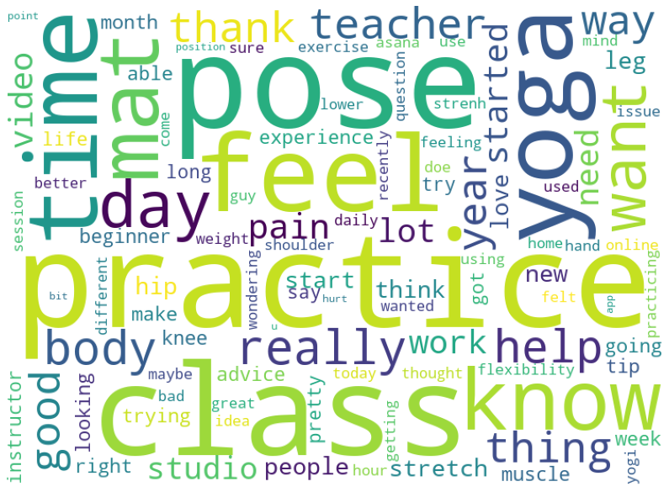
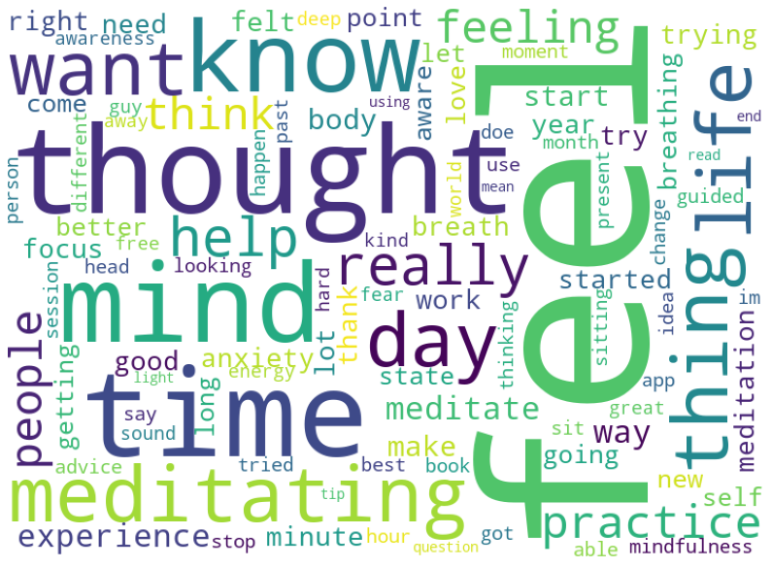
EDA: Word Cloud
Yoga
Meditation
From Yoga subreddit title+post, we can see some common words such as practice,class,pose,feel,time and mat.
From Meditation subreddit title+post, we can see some common words such as feel,thought,know,mind,help, people,day and time.

Slide 15
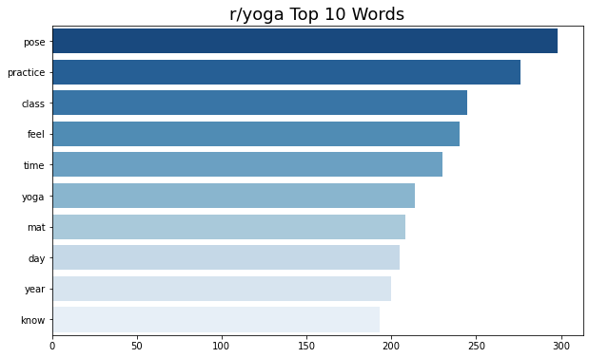
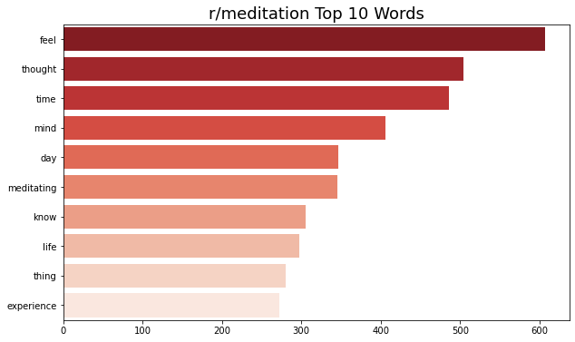
EDA: top words
Yoga
Meditation
Top words from r/yoga are pose, practice, class and also mat. I think the community likes to share on different poses. In terms of marketing, we can entice users by giving out free mats etc.
Top words from r/meditation focuses on feeling, thoughts, mind etc. To promote yoga to this group, we need to incorporate mind empowerment as well.

Slide 16
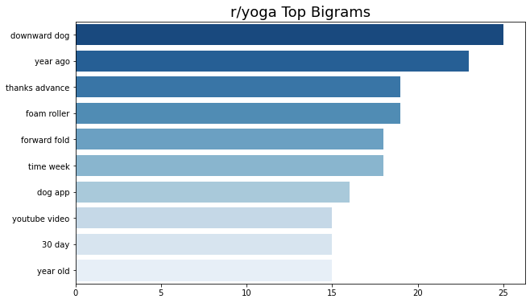
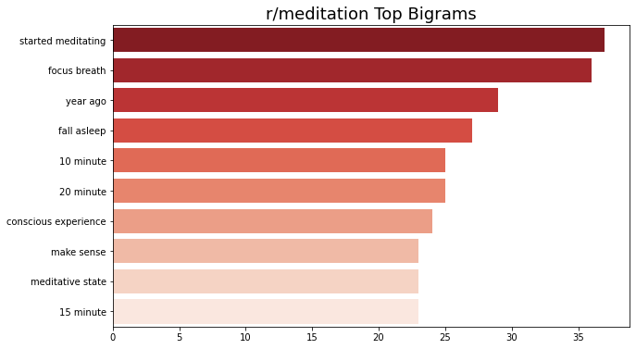
EDA: top bigram
Yoga
Meditation
Top bigram for r/meditation are breathing related, sleep improvement, and duration of meditation. This can be a good point to bring up as yoga also helps sleep quality and improve mind consciousness.
Top bigram for r/yoga are type of poses, tools like foam roller or video based tutorials from dog app or youtube. It could be an interesting selling point to promote packages with foam roller or kickstart virtual yoga classes for people who are interested in yoga.

Slide 17
Pre-processing
Model Selection

Slide 18
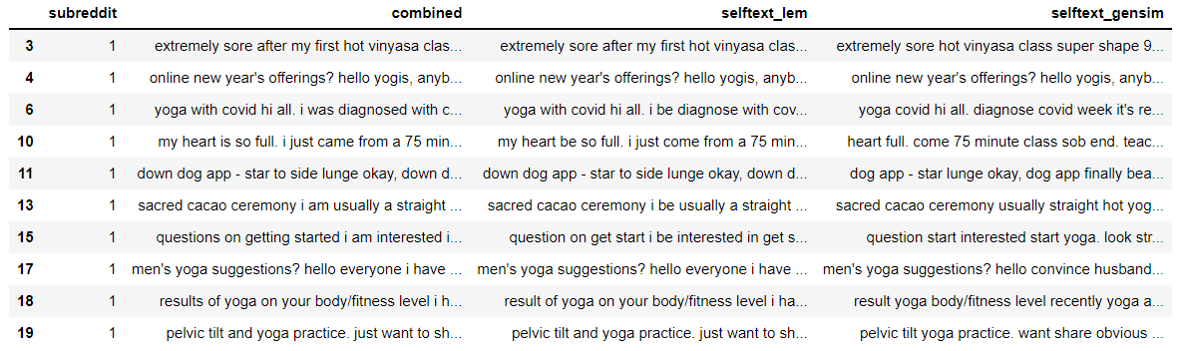
Pre-processing workflow
02
03
01
Lemmatization (Focusing on nouns)
Removal of stopwords (via gensim)
title + self-text

Slide 19
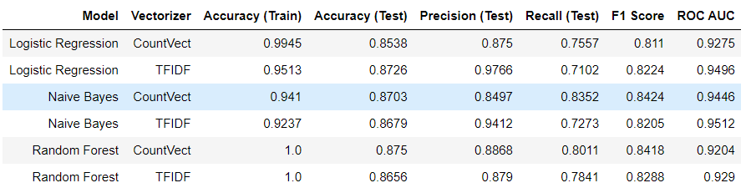
Model selection
Our aim is to maximise the true positives (Correctly classifying r/yoga posts)
We focus on the following metrics:
Precision (How many did we catch?)
Recall (How many did we miss?)
F1 score; Finding a right balance between Precision and Recall

Slide 20
Model Insights

Slide 21
Top Probabilities Predictors - r/yoga
Practice
Pose
Class
Feel
0.73%
0.67%
0.64%
0.52%
Body
Teacher
Mat
Pain
0.37%
0.37%
0.33%
0.31%
*List is not exhaustive
Notes:
probabilities of appearing in the class out of all the words in the corpus

Slide 22
Concerns & Challenges by Yoga Enthusiasts
Body Posture
Effect & Feeling
Incorrect posture during self practice
Difficult for beginner: Downward dog
Body soreness or pain after yoga
Hip tight

Slide 23
Wrongly stretching your body or doing incorrect asanas, and breathing in an incorrect manner while exercising, can be detrimental to your health. Incorrect postures could lead to acute pain and long-standing chronic problems, say doctors.
Source: ALERT: Ways yoga can harm you - Times of India (indiatimes.com)

Slide 24
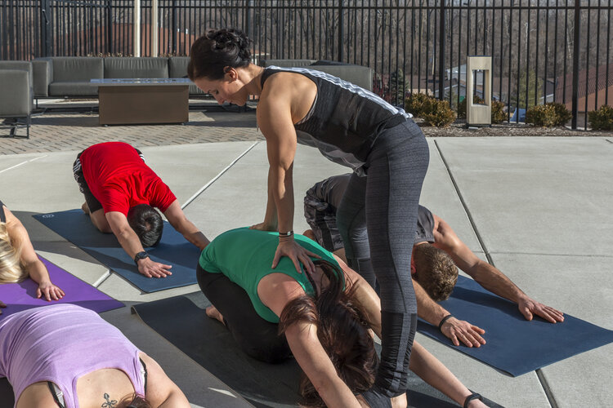
Additional Co-Instructor
Provide guidance on body posture during the class when main instructor is doing the yoga

Slide 25

Member Privilege (1)
Complimentary Yoga Mat
For new member sign up with our Yoga Studio’s membership & classes

Slide 26
22 Unique Words
28 Commonality Words
r/yoga - r/Meditation
Top 50 Predictors

Slide 27
Unique Trending Words - r/yoga
Flexibility
Video
Flexibility of back or shoulder
Lacking of flexibility
Searching for yoga video
For male or variety of yoga postures

Slide 28
Member Privilege (2)
Exclusive Yoga Videos Access
Members can access to latest Yoga Videos via website and phone app 24/7 anywhere

Slide 29
Conclusions & Recommendations

Slide 30
Text Classifier Model
Improve Efficiency and Effectiveness of Marketing Team
Top Predictors
Identify the key words that can improve our product and services
Trending Words
Develop Marketing Strategies as per trending
Commonality
Targeting on new segment that have in common interest

Slide 31
Future Enhancements
More Data
Sentiment Analysis
Get data from Hot and Top Sections of subreddit
On Comments section on subreddit posts
Different Models
Update Stop Words
Explore SVM, Gradient Boosting and Deep Learning Models
Input less meaningful words into stop words list

Slide 32
Thanks

Slide 33
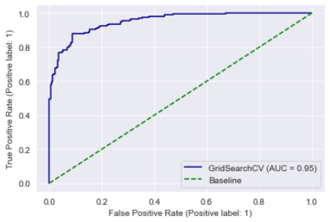
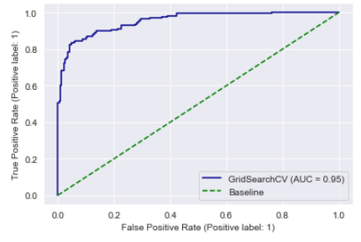
Differentiating our top-performing models
Naive Bayes
CountVectorizer
Naive Bayes
TFIDF
F1 scores provide a snapshot of model performance relative to a fixed threshold (Our preference)

Slide 34
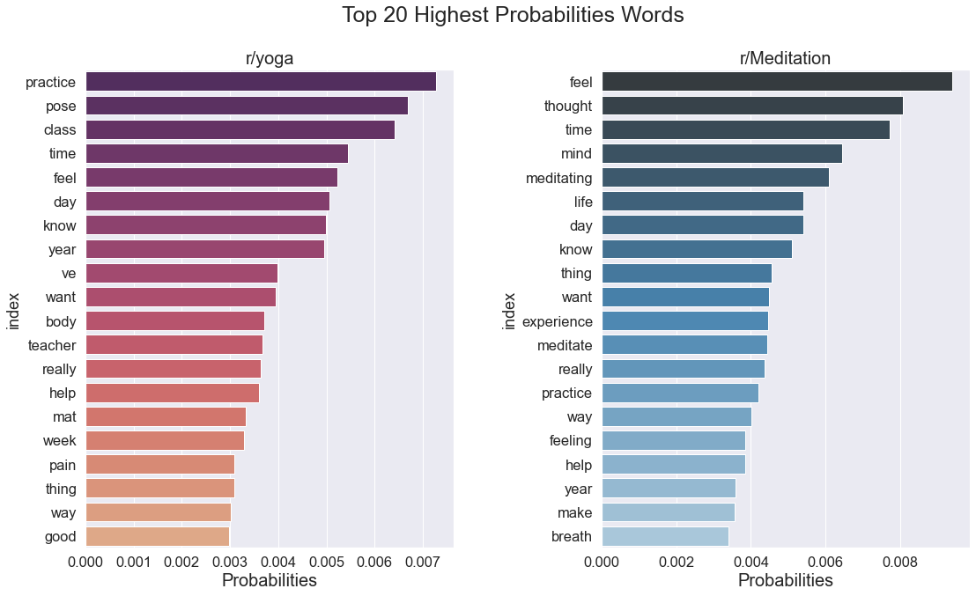

Slide 35
